Slide 1
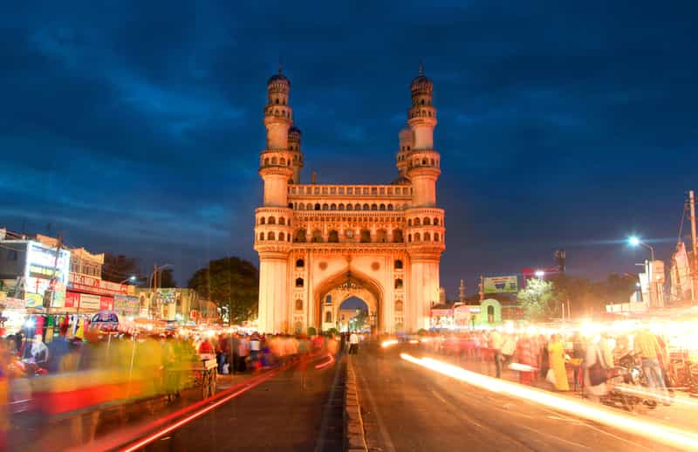
INSIGHTS FOR TELANGANA GOVERNMENT TOURISM DEPARTMENT

Slide 2
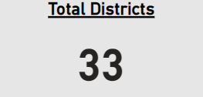
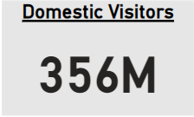
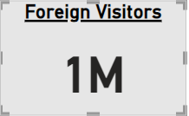
General Insights
There are total 33 districts in the Telangana state.
Approximately 1 Million foreigners visited Telangana state during year 2016-2019.
Approximately 356 Million are domestic visitors in Telangana during year 2016-2019.

Slide 3
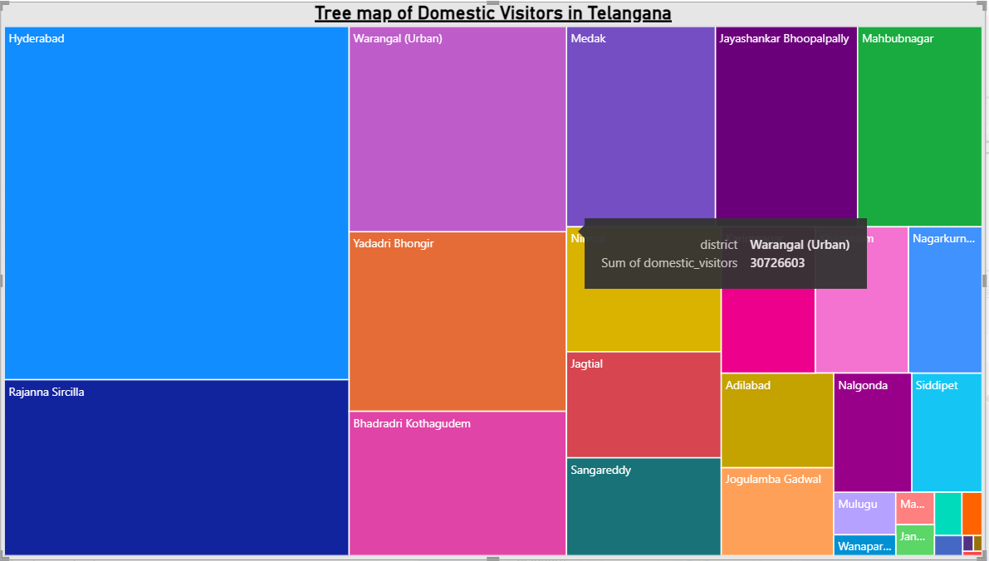
Dominated state
Following tree map shows that Hyderabad has the most domestic visitors. Hyderabad attracts most of the tourists. So Government should focus on the development of Hyderabad tourism.

Slide 4
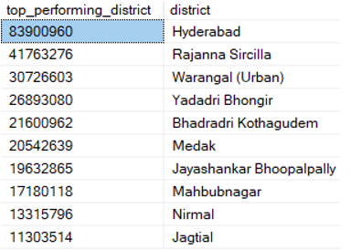
Top 10 districts -that have the highest number of domestic visitors overall (2016-2019).
The table shows :
Hyderabad ,Rajana Sircilla and Warangal districts are top performing districts for Telangana state.

Slide 5
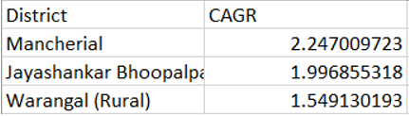
Top 3 districts -based on compounded annual growth rate of visitors between(2016-2019).
Annual rate of visitors from 2016-2019 is increased for the districts Mancherial, Jayashankar Bhoopalpally and Warangal(Rural).
That is the tourism in these districts is increasing compared to other districts.

Slide 6
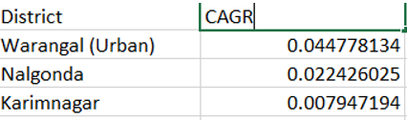
Bottom 3 districts -based on compounded annual growth rate of visitors between 2016-2019.
Annual rate of visitors for the districts Warangal(Urban), Nalgonda and Karimnagar Is very low.
So Government can take proper action in the development of tourism in these districts.

Slide 7
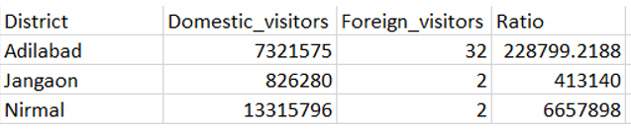
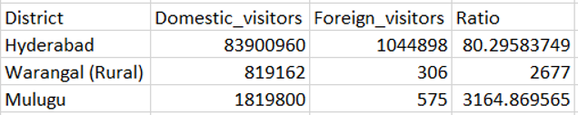
Top & bottom 3 districts -based on high domestic to foreign tourist ratio.
High Ratio -
Low Ratio -

Slide 8
Which District Has The Highest Potential For The Tourism Growth?
Hyderabad has the most number of visitors.
Highest revenue is contributed by Hyderabad.
Foreign to Domestic Ratio is High.
Hyderabad has the most attractive tourist places.

Slide 9
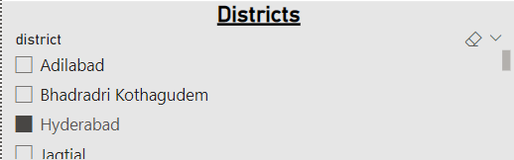
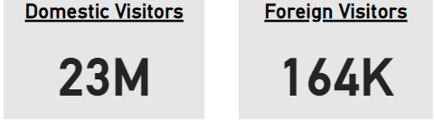
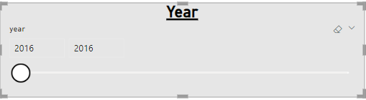
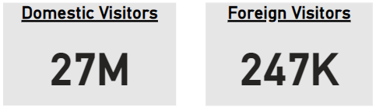
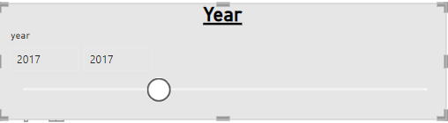
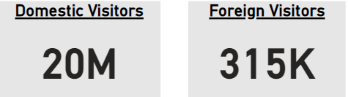

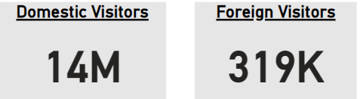
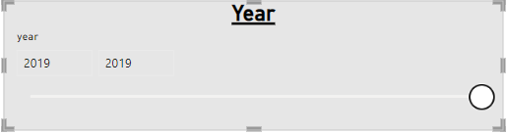
Summary of Hyderabad

Slide 10
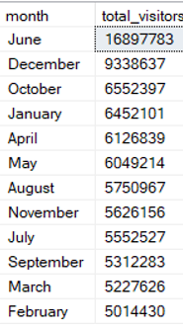
The peak and low season months -for the Hyderabad based on data from 2016-2019 for Hyderabad district.
As we see from the table most tourists visit Hyderabad during the month of June and less during the month of February.
Recommendations to the Government.
Organize events.
Discounts.
Collaboration with Hotels and Restaurants.

Slide 11
How Hyderabad Can Emulate The Dubai Tourism Model?
Unique and innovative attractions
Create tourism clusters
Investments
Infrastructure

Slide 12
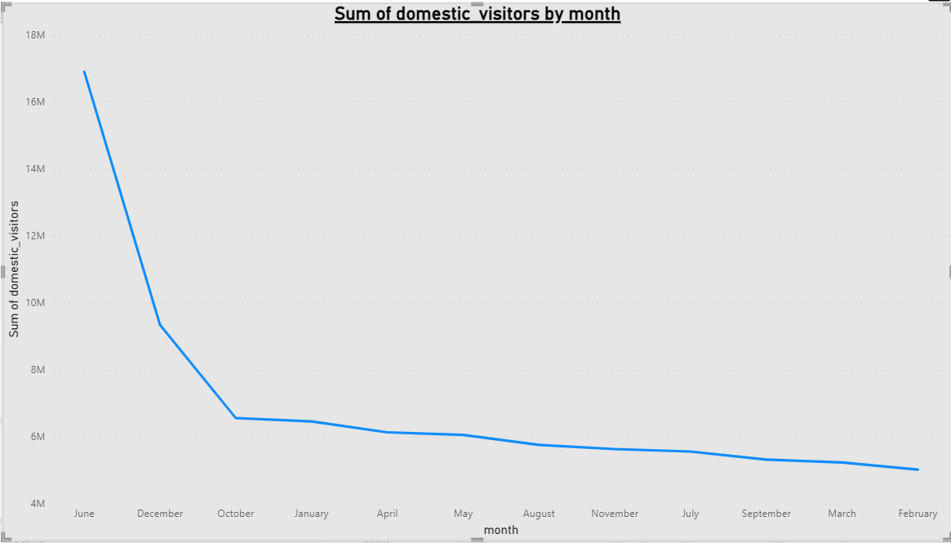
The following graphs shows the number of Domestic Visitors by Month(Hyderabad).

Slide 13
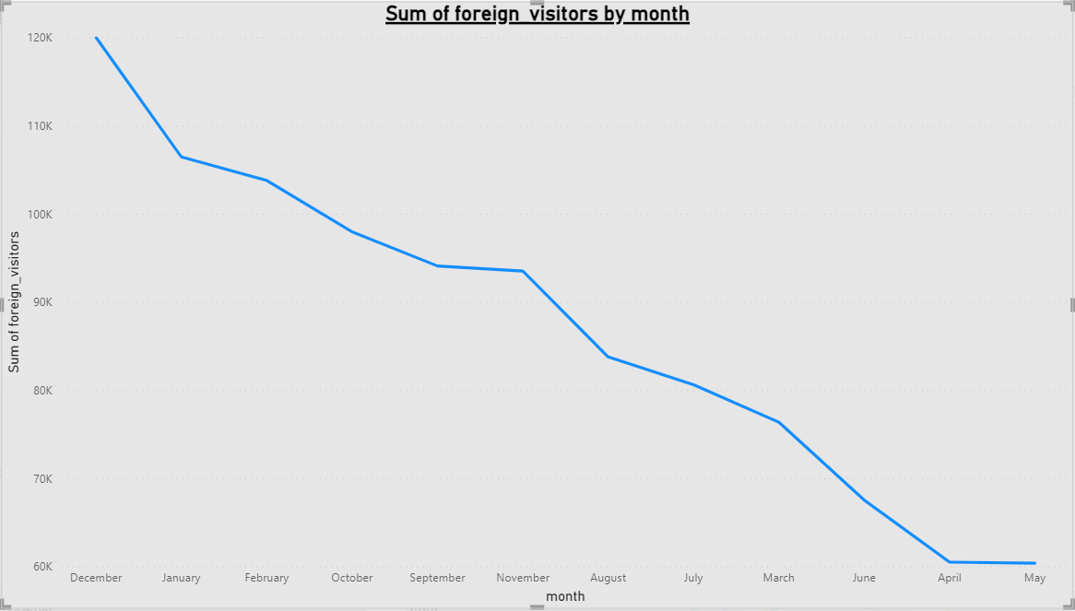
The following graphs shows the number of Foreign Visitors by Month(Hyderabad).

Slide 14
Thank You !

